Slide 1












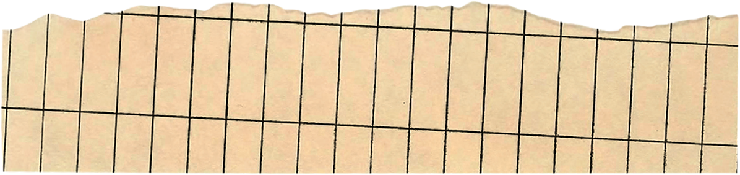
Data Preparation & Exploration for Machine Learning Models
By: Ahmed El-Metwally

Slide 2
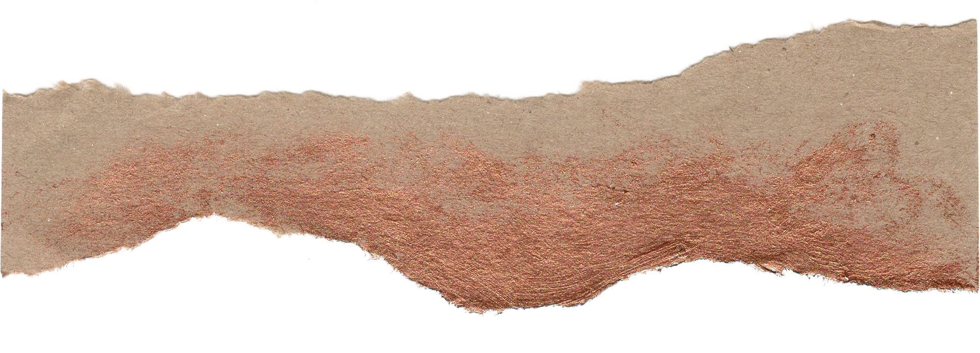






Agenda
Machine Learning Life cycle
Data pyramid
Variable / Feature
Independent & Dependent variable
Qualitative & Quantitative Data
Data Quality Dimensions
Most Imoprtant stage in machine learning life cycle?

Slide 3
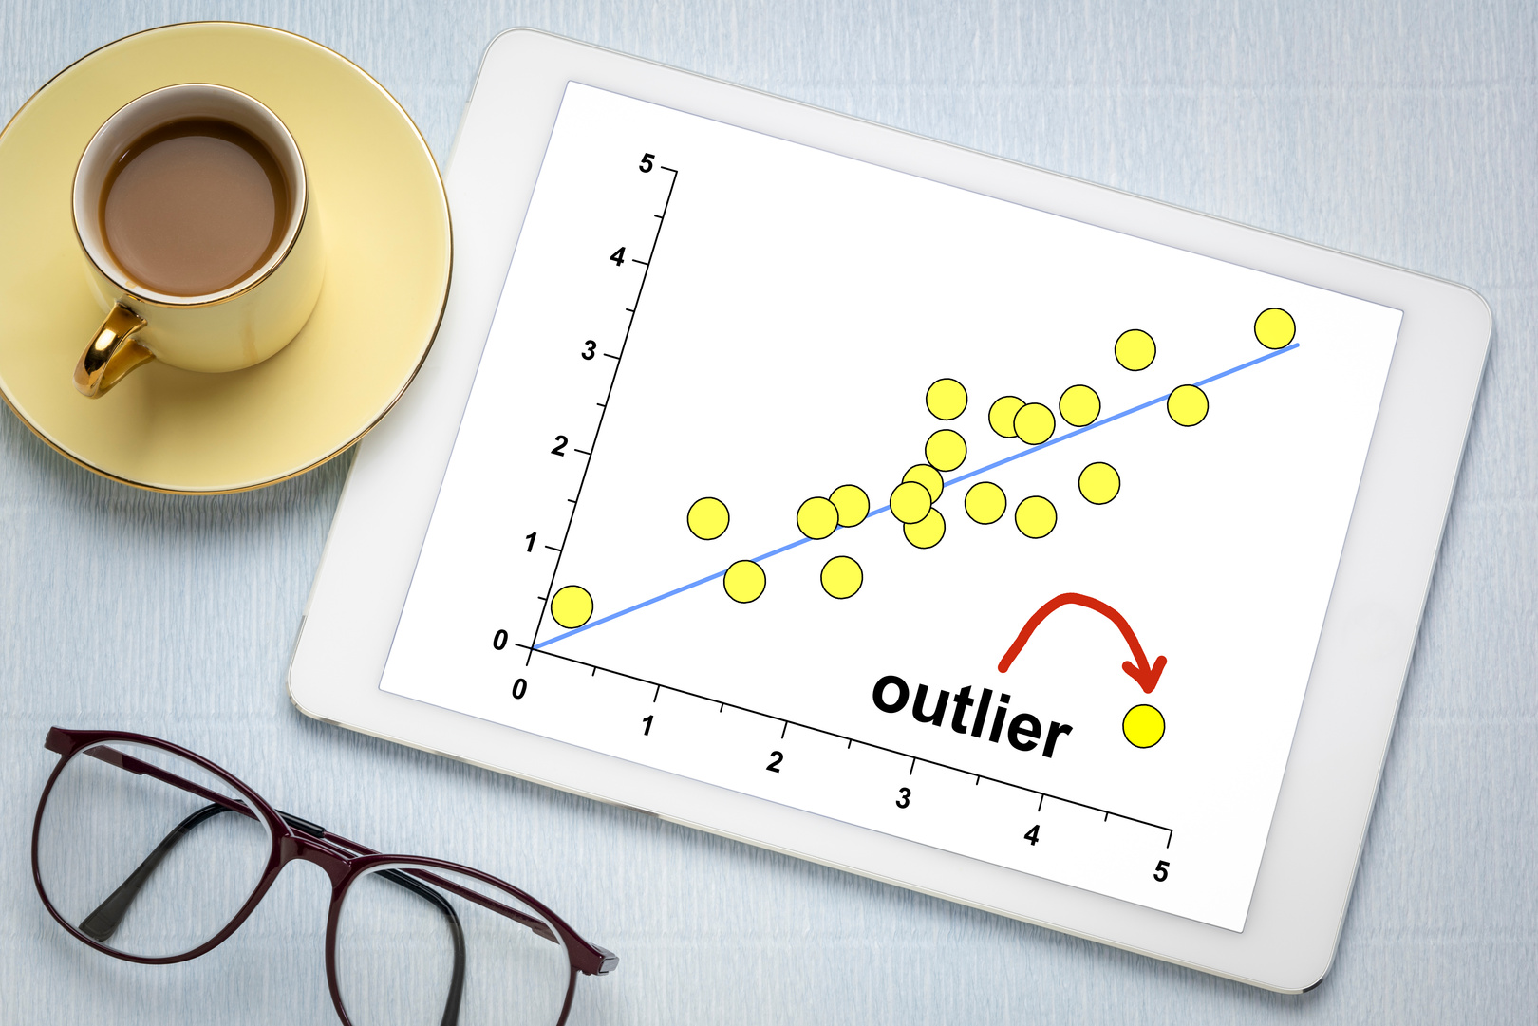
Agenda
Dealing with Missing values
Transforming Categorical Data
Outliers
Example from Real Project
Discussion: How to deal with Competitions specially Egypt IoT & AI Challenge
Are Outliers affect my decisions?

Slide 4

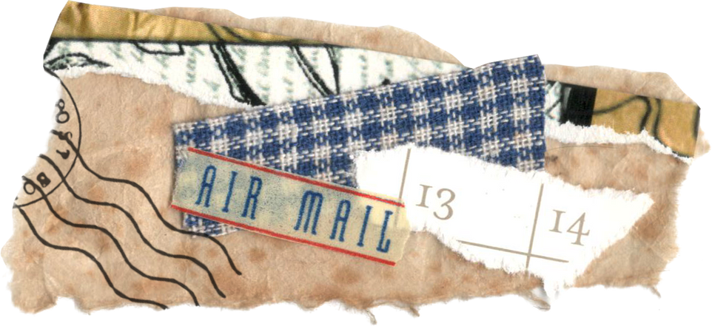




Machine Learning Life cycle
Define Project Objectivies
Data Acquisition
Data Exploration
What's the benefit of that?
Collecting new data
Converting legacy data
Sharing data
Using descriptive statistics
Using Visualization
Explore Missing values, outliers, ....
Data Preparation
Machine Learning Model
How to solve these problems that we explored?
Train
Evaluate

Slide 5

Data Pyramid
Wisdom
Knowlodge
Information
Row Data

Slide 6
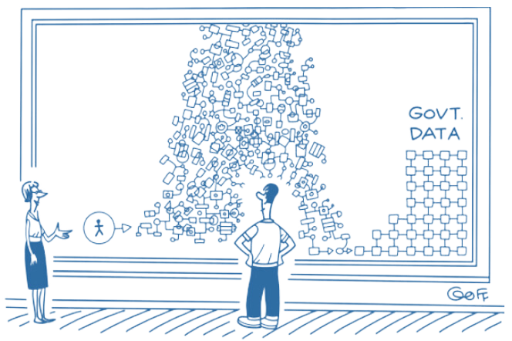
Garbage IN, Garbage OUT!

Slide 7
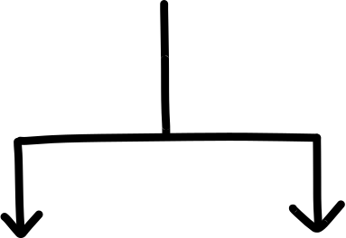
Variable
What is Variable?
Any characteristics, number, or quantity that can be measured or counted.
Examples:
Age
Gender
Salary
expenses
country of birth
eye color
Independent
Variable
Dependent

Slide 8
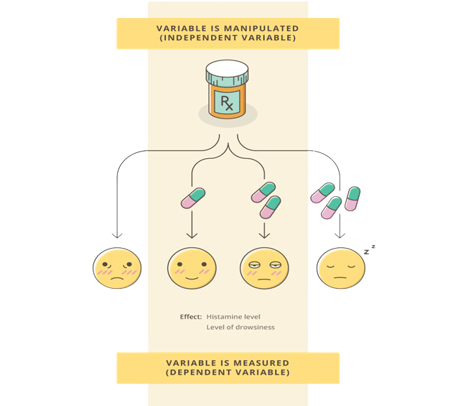
Independent & Dependent variable

Slide 9
Independent & Dependent variable
Independent Variable
Also known as predictor variable or input variable.
Independent variables are typically the features or factors being analyzed to understand their relationship with the dependent variable.
These variables are usually plotted on the x-axis of graphs or charts during exploration.
Examples include age, gender, temperature, etc.

Slide 10
Independent & Dependent variable
Dependent Variable
Also known as response variable or output variable.
It's the variable being studied and measured.
The focus is often on understanding how changes in the independent variables affect the dependent variable.
Dependent variables are usually plotted on the y-axis of graphs or charts during exploration.
Examples include sales revenue, test scores, temperature change, etc.

Slide 11
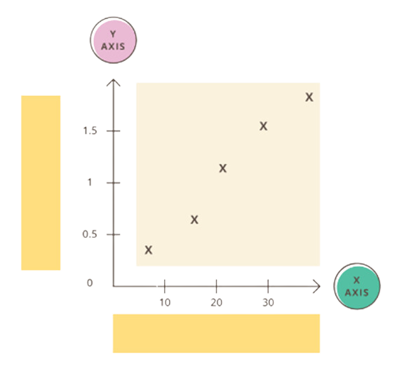
Independent & Dependent variable
Dependent variable
Independent variable

Slide 12
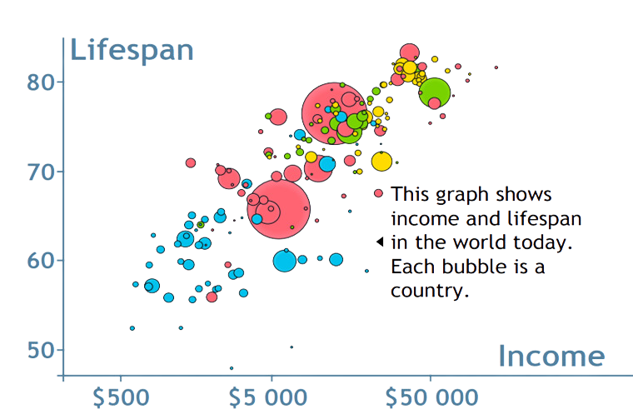
Independent & Dependent variable

Slide 13
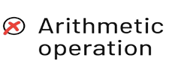
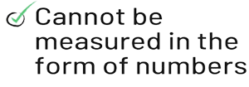
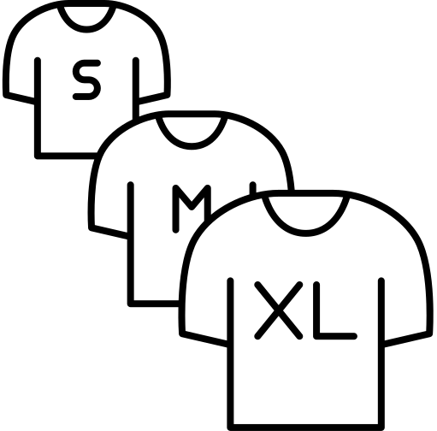







Qualitative & Quantitative Data
Oridnal Data
Qualitative Data
Nomial Data
Also known as categorical Data
It is non-numerical and typically consists of words, descriptions, observations, or categories.
Examples include colors, emotions, opinions, preferences, and themes.

Slide 14
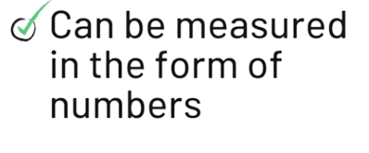
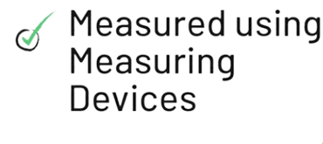
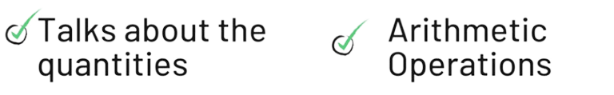
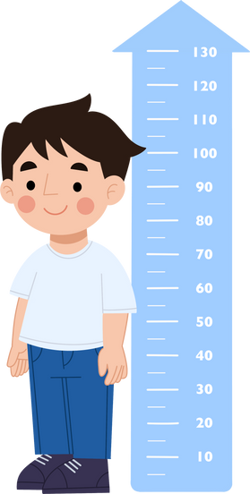
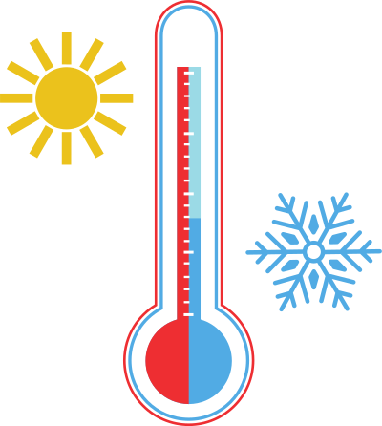
Qualitative & Quantitative Data
Interval Data
Quantitative Data
Ratio Data
Also known as Numerical Data
Quantitative data represents quantities or numerical values.
Quantitative data can be discrete (countable) or continuous (measurable).
Examples include height, weight, temperature, test scores, and sales figures.

Slide 15
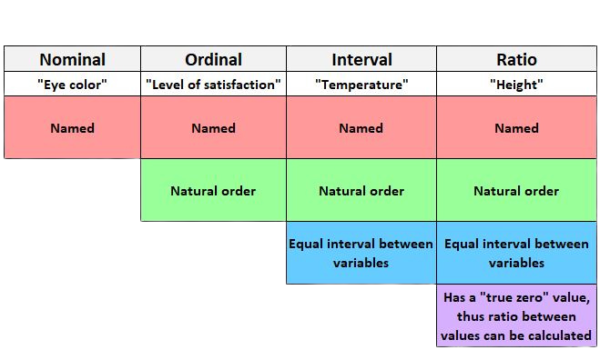
Level of Measurements

Slide 16
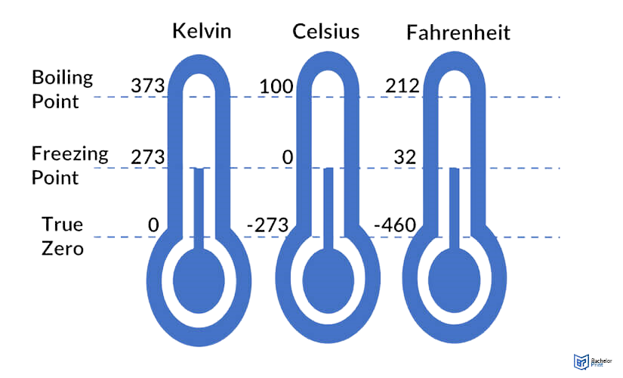
Interval and Ratio Data Example

Slide 17
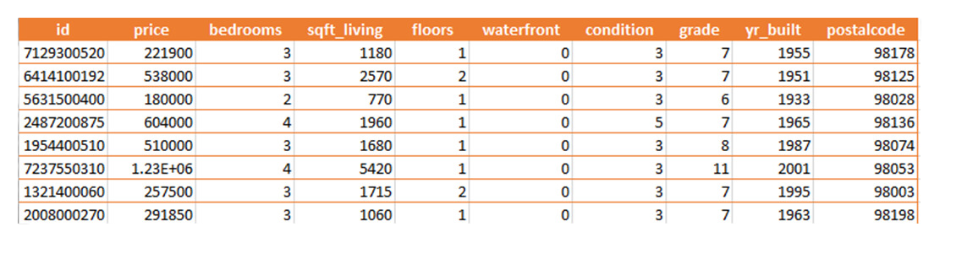
Example

Slide 18
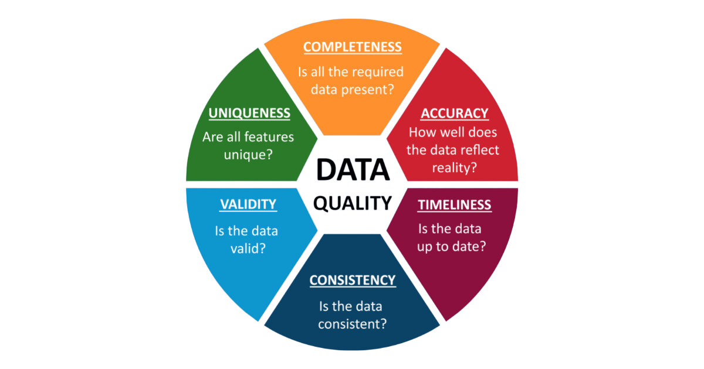
Data Quality Considerations

Slide 19
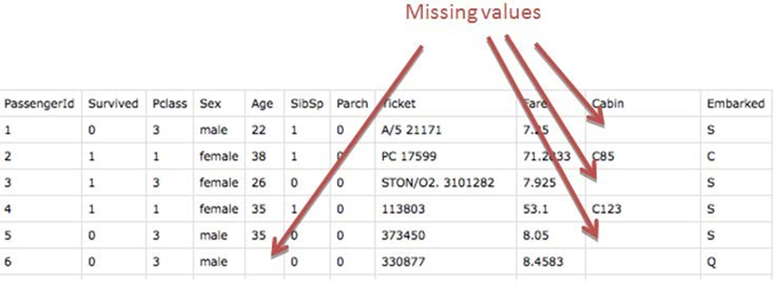
Missing Values

Slide 20
Deleting Columns & Rows with Missing Values
Here, we either delete a particular row if it has a null value for a particular feature and a particular column if it has more than 70-75% of missing values.
This method is advised only when there are enough samples in the data set.
Removing the data will lead to loss of information which will not give the expected results while predicting the output.

Slide 21
Missing Values
Handling Continuous variables
This strategy can be applied on a feature which has numeric data like the age of a person.
We can calculate the mean, median or mode of the feature and replace it with the missing values.
This is an approximation which can add variance to the data set.
But the loss of the data can be negated by this method which yields better results compared to removal of rows and columns.

Slide 22
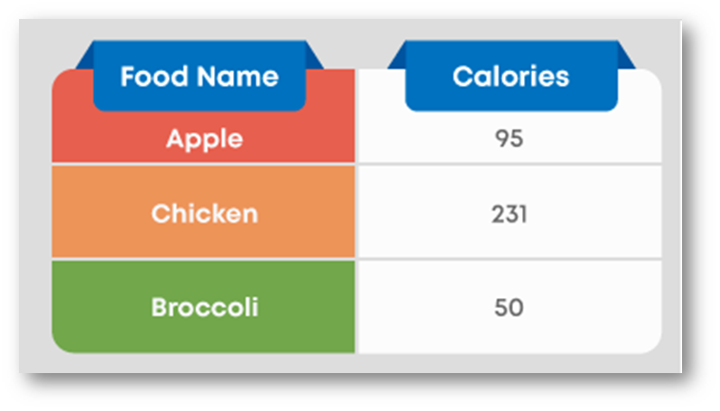
Transforming Categorical Data

Slide 23
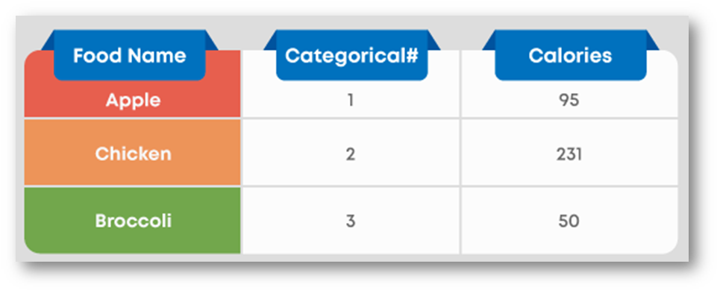
Label Encoding

Slide 24
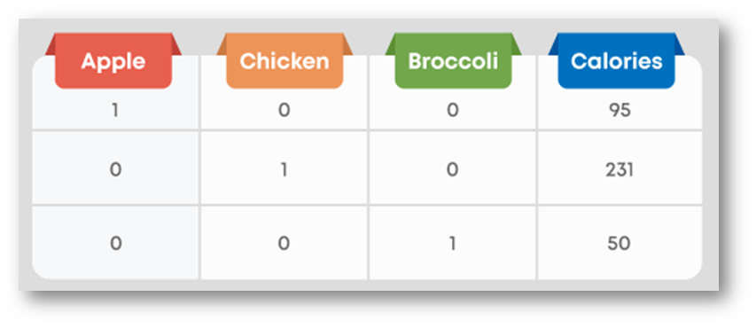
One-Hot Encoding

Slide 25
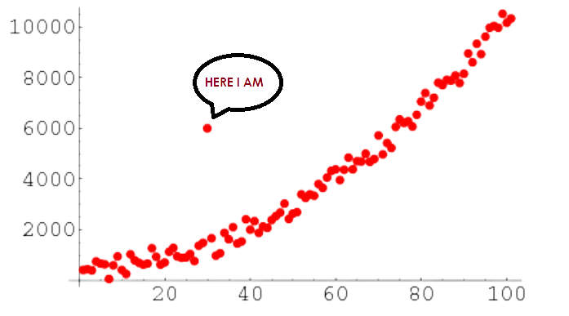
Outliers
An outlier is a data point that lies far away from the majority of the other data points.
Outliers can occur due to various reasons, including natural variability, measurement errors, or data processing errors.

Slide 26
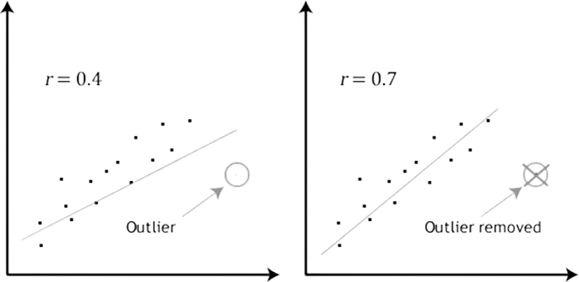
Impact Of Outliers On Linear Regression

Slide 27


Discussion: How to deal with Competitions specially Egypt IoT & AI Challenge
How to think correctly to create a good project from the beginning to participate in competitions

Slide 28

Thank You

